Slide 1
GME Office
House Staff Council
Clinical Fellows Council
GME Situational Update
8/23/2021

Slide 2
Leadership Panel
Jessica Bienstock, MD MPH – Designated Institutional Official
Peter Hill, MD – Senior Vice President for Medical Affairs
Gabe Kelen, MD – EMed Dept Chair & CEPAR Director
Kathleen Hiltz, MD – House Staff Council President
Eva Valilis, MD – Clinical Fellows Council Chair

Slide 3
Agenda
State of the House [Covid Numbers at Hopkins]
COVID among trainees
Updates
Questions

Slide 4
State of the House
Notes:
Change date immediately. Change time right before submission.
Make sure your name/title is in bottom left, so people know who to email questions to.

Slide 5
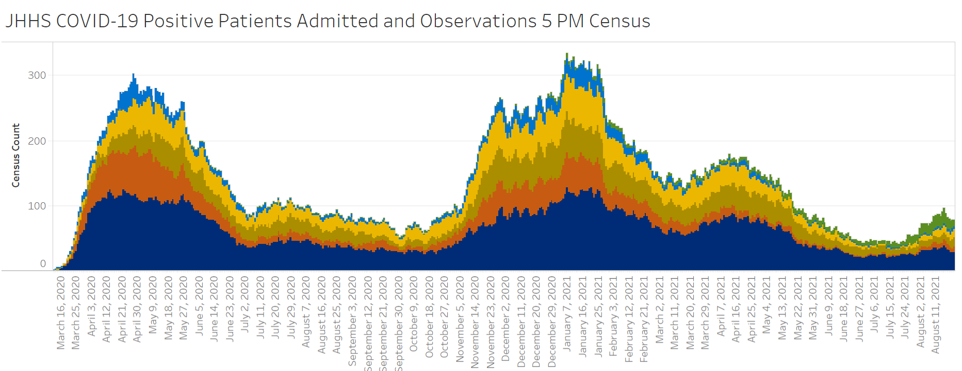

Slide 6
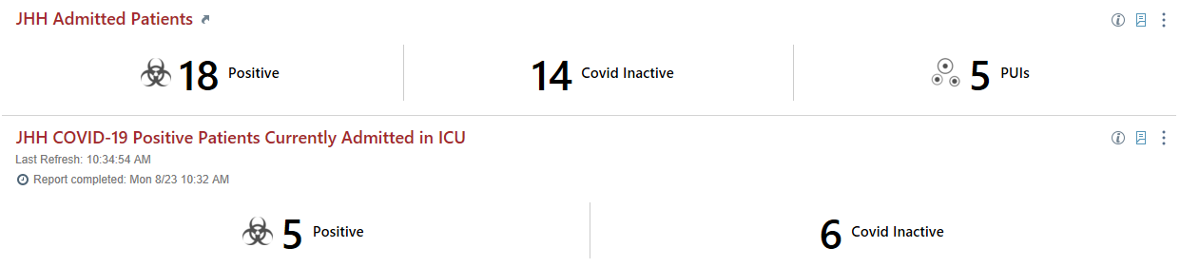
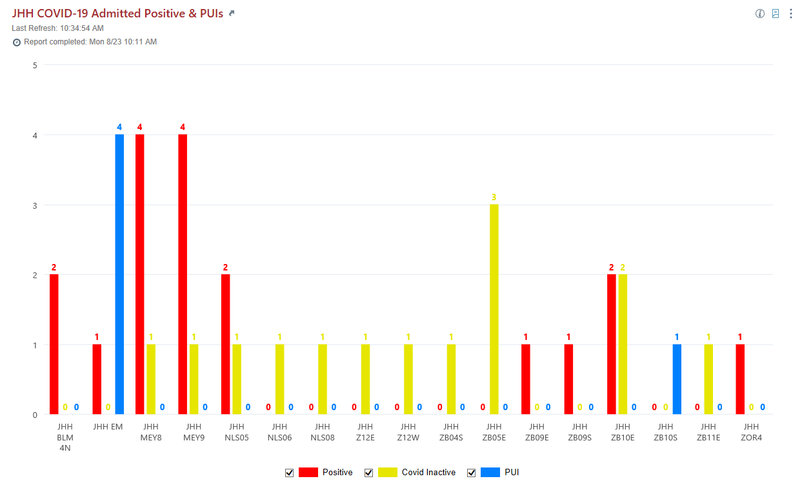
JHH COVID Census - 8/23/21
Notes:
Epic COVID Monitoring Dashboard

Slide 7
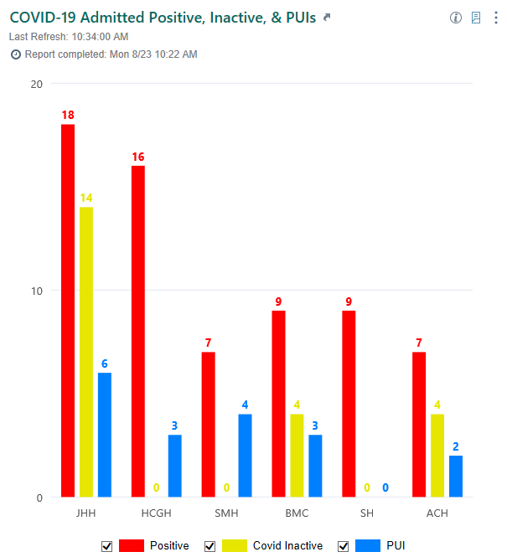
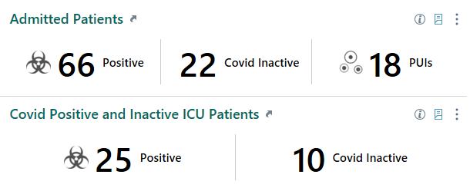
JHM COVID Census - 8/23/21

Slide 8
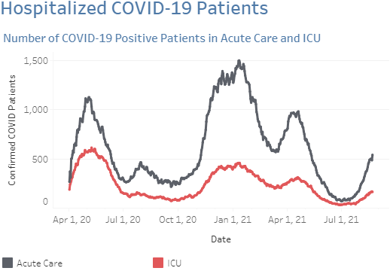
Statewide Covid Hospitalizations
Notes:
https://reports.crisphealth.org/

Slide 9
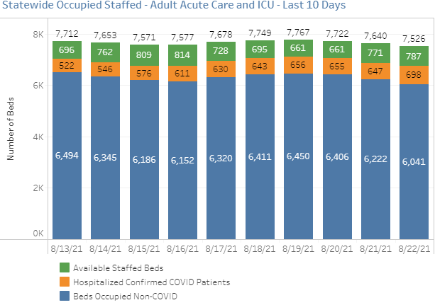

Slide 10
Johns Hopkins Hospital Surge Plan 4.0 - Revised 8/19 5PM
PHASE 1 – A (8/17)
20 COVID BEDS
PHASE 1 – B (TBD)
28 COVID BEDS
PHASE 1 – C (TBD)
35-40 COVID BEDS
MPCU (Nelson 5)*
Mixed Acuity
4 Beds (2 ICU)
MPCU (Nelson 5)*
Mixed Acuity
4 Beds (2 ICU)
MPCU (Nelson 5)*
Mixed Acuity
4 Beds (2 ICU)
Meyer 9*
Acute Care
4 Beds
Meyer 9*
Acute Care
4 Beds
Meyer 9*
Acute Care
4 Beds
Meyer 8
Acute Care
4 Beds
Meyer 8
Acute Care
4 Beds
Meyer 8
Acute Care
4 Beds
Nelson 4
Acute Care
21 Beds
Nelson 4 & 6
Acute Care
8 Beds (4 each unit)
Nelson 4
Acute Care
13 Beds
Zayed 11 East
Acute Care
21 Beds
OR
Zayed 11 East
Acute Care
21 Beds
Zayed 11 East
Acute Care
8-9 Beds
MICU (Zayed 10E)*
ICU
5 beds
MICU (Zayed 10E)*
ICU
5 beds
MICU (Zayed 10E)*
ICU
12 beds
SICU (Zayed 9E)
ICU
3 beds
SICU (Zayed 9E)
ICU
3 beds
SICU (Zayed 9E)
ICU
3 beds
PACU
ICU
4 beds
PACU
ICU
4 beds
PACU
ICU
4 beds
Goals:
Assure capacity for COVID patients who are admitted via JHH EDs
Keep ORs running as long as possible
Move COVID-19/PUI patients to be admitted out of the ED ASAP
Utilize the COVID-19 Alternate Care Sites to fullest extent
† If/when needed AND if census drops to allow
* Can split half at a time
Legend:
NON-COVID UNIT
Acuity
Number of Beds
NEG PRESSURE COVID
Acuity
Number of Beds
PARTIAL COVID UNIT
Acuity
Number of Beds
DRAFT

Slide 11
Johns Hopkins OB & Children’s Center Surge Plan - Revised 8/23 11 AM
PHASE 1 – A (8/17)
X COVID BEDS
PHASE 1 – B (TBD)
X COVID BEDS
PHASE 1 – C (TBD)
X COVID BEDS
Zayed 8W
OB
2 Beds
Zayed 8W (if volume allows)
OB
4 Beds
Zayed 8W (if volume allows)
OB
4 Beds
Zayed 8E
L&D
4 Beds
Zayed 8E
L&D
4 Beds
Zayed 8E
L&D
4 Beds
JHCC Beds
Pediatric ICU
X Beds
JHCC Beds
Pediatric ICU
X Beds
JHCC Beds
Pediatric ICU
X Beds
JHCC Beds
Pediatric Acute Care
X Beds
JHCC Beds
Pediatric Acute Care
X Beds
JHCC Beds
Pediatric Acute Care
X Beds
Goals:
Assure capacity for COVID patients who are admitted via JHH EDs
Keep ORs running as long as possible
Move COVID-19/PUI patients to be admitted out of the ED ASAP
Utilize the COVID-19 Alternate Care Sites to fullest extent
† If/when needed AND if census drops to allow
* Can split half at a time
Legend:
NON-COVID UNIT
Acuity
Number of Beds
NEG PRESSURE COVID
Acuity
Number of Beds
PARTIAL COVID UNIT
Acuity
Number of Beds
DRAFT

Slide 12
Residency | # Positive | # Trainees | % Positive
Emergency Medicine | 7 | 48 | 14.6%
Anesthesiology | 6 | 85 | 7.1%
Surgery | 5 | 66 | 7.6%
Internal Med (JHH + BV) | 4 | 191 | 2.1%
Otolaryngology | 3 | 26 | 11.5%
Gynecology & Obstetrics | 2 | 35 | 5.7%
Neurology | 2 | 26 | 7.7%
Ophthalmology | 2 | 20 | 10.0%
Pediatrics | 2 | 80 | 2.5%
Plastic Surgery | 2 | 29 | 6.9%
Psychiatry | 2 | 49 | 4.1%
Urology | 1 | 18 | 5.6%
Neurosurgery | 1 | 29 | 3.4%
Orthopaedic Surgery | 1 | 31 | 3.2%
All other residencies | 3 | 203 | 1.5%
Residents TOTAL | 43 | 936 | 4.6%
Fellows TOTAL | 16 | 513 | 3.1%
GME TOTAL | 59 | 1,449 | 4.1%
Trainees with Covid
(since March 2020) (updated 8/23/21)
* only cases for individuals still active at JHU

Slide 13
Updates
Events
  Masks required if within 6 feet of others
  All food and drink must be individually packaged and consumed while physically distanced
  Indoor events limited to 25 people
  Outdoor events limited to 50 people
Reminder that there is a “Doctors’ Dining Room” behind the HS lounge to allow for physically distanced eating

Slide 14
Updates
Away Electives
  Per Dr. Maragakis- Away electives are allowed.
  Traveling learners should follow federal, state and local public health guidance for travel which might include testing or quarantine.

Slide 15
Updates
Patient Care
  Eye protection is required when within 6 feet of a patient or in a patient room / bay
  Inpatient rounding = 6 people plus the patient
  Outpatient care = 3 people plus the patient

Slide 16
Updates
Vaccine mandate
  Deadline for vaccination is Sept 1
  If unvaccinated, incompletely vaccinated, or vaccinated with a vaccine other than Moderna, Pfizer, or J&J will need to test weekly.
  If you have received an email from me asking you to upload evidence of your vaccination, please do so or email me at jbienst@jhmi.edu

Slide 17
Questions
….thank you for submitting them!

Slide 18
Asymptomatic saliva testing for employees
  Will become increasingly available
  No co-pay required
Booster shots: who will get them, when we will get them

Slide 19
What was the thought process behind the changing recommendations about the size of gatherings and to what extent do concerns about resident education play in?
There is a paradox in re-implementing restrictions with simultaneously implementing the mandatory vaccination. Why is this, and will booster shots play into the decision to relax these restrictions?

Slide 20
What are the current statistics for COVID infection among JHH employees? Specifically, what is the rate of COVID infection in vaccinated individuals now compared to what it was prior to delta variant?

Slide 21
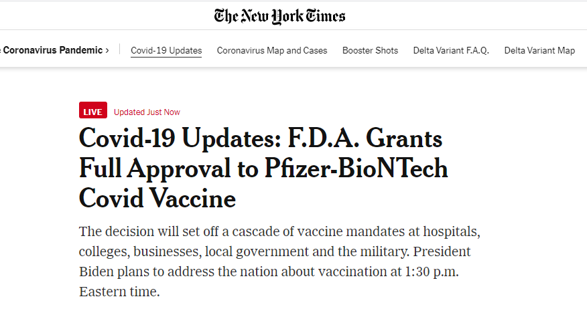

Slide 22

Submit questions for next time here:

