Slide 1
GME Office House Staff Council Clinical Fellows Council GME Situational Update
9/9/2021

Slide 2
Leadership Panel
Jessica Bienstock, MD MPH – Designated Institutional Official
Peter Hill, MD – Senior Vice President for Medical Affairs
Gabe Kelen, MD – EMed Dept Chair & CEPAR Director
Kathleen Hiltz, MD – House Staff Council President
Eva Valilis, MD – Clinical Fellows Council Chair

Slide 3
Agenda
State of the House [Covid Numbers at Hopkins]
COVID among trainees
Updates
Questions

Slide 4
State of the House
Notes:
Change date immediately. Change time right before submission.
Make sure your name/title is in bottom left, so people know who to email questions to.

Slide 5
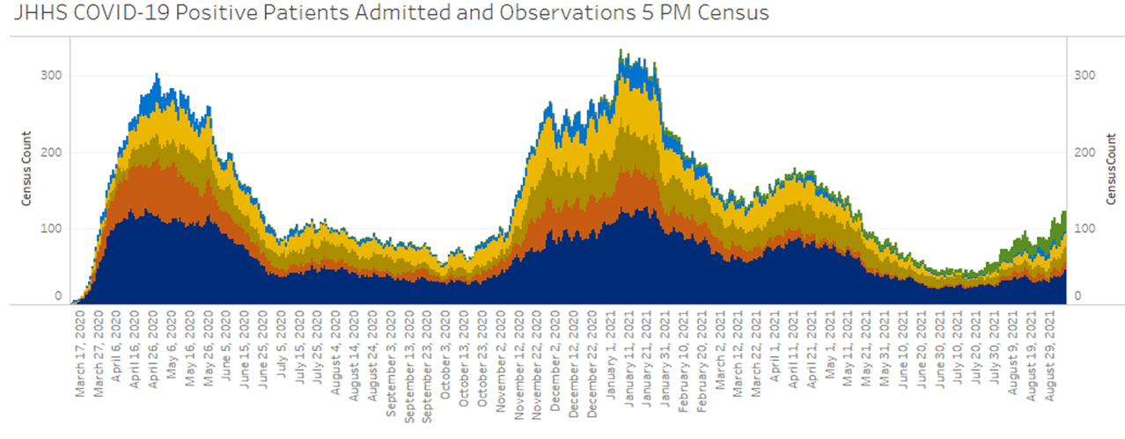

Slide 6
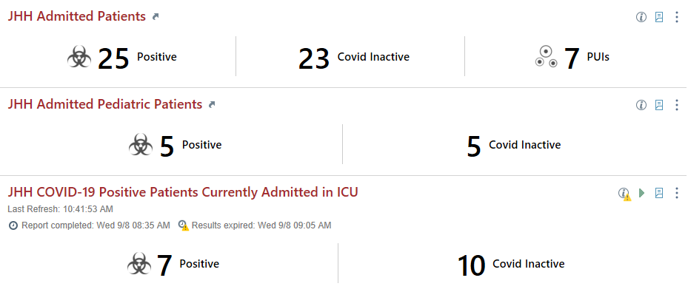
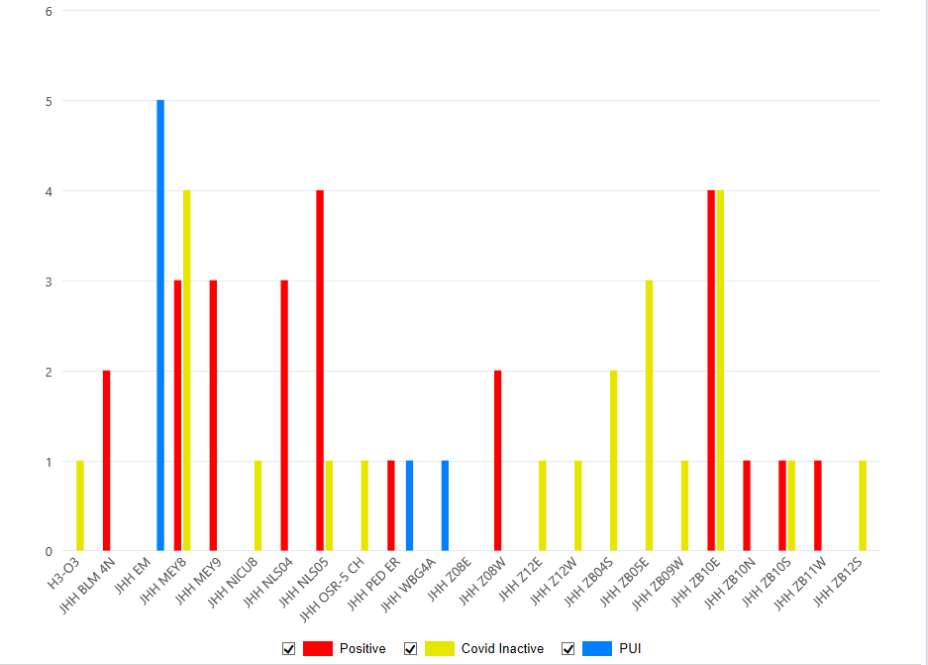
JHH COVID Census - 9/8/21
Notes:
Epic COVID Monitoring Dashboard

Slide 7
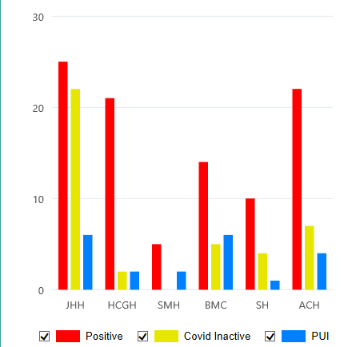
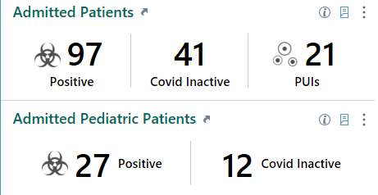
JHM COVID Census - 8/23/21

Slide 8
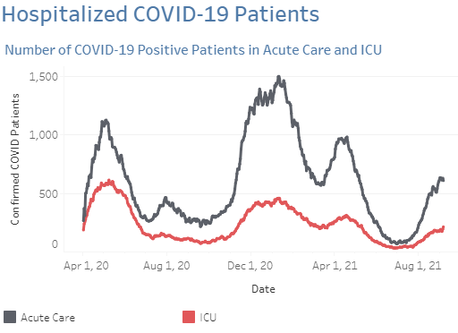
Statewide Covid Hospitalizations
Notes:
https://reports.crisphealth.org/

Slide 9
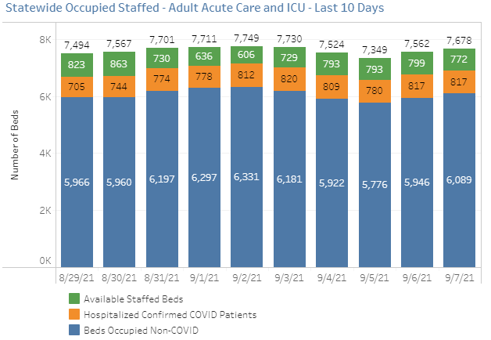

Slide 10
Johns Hopkins Hospital Surge Plan 4.0 - Revised 8/19 5PM
PHASE 1 – A (8/17)
20 COVID BEDS
PHASE 1 – B (TBD)
28 COVID BEDS
PHASE 1 – C (TBD)
35-40 COVID BEDS
MPCU (Nelson 5)*
Mixed Acuity
4 Beds (2 ICU)
MPCU (Nelson 5)*
Mixed Acuity
4 Beds (2 ICU)
MPCU (Nelson 5)*
Mixed Acuity
4 Beds (2 ICU)
Meyer 9*
Acute Care
4 Beds
Meyer 9*
Acute Care
4 Beds
Meyer 9*
Acute Care
4 Beds
Meyer 8
Acute Care
4 Beds
Meyer 8
Acute Care
4 Beds
Meyer 8
Acute Care
4 Beds
Nelson 4
Acute Care
21 Beds
Nelson 4 & 6
Acute Care
8 Beds (4 each unit)
Nelson 4
Acute Care
13 Beds
Zayed 11 East
Acute Care
21 Beds
OR
Zayed 11 East
Acute Care
21 Beds
Zayed 11 East
Acute Care
8-9 Beds
MICU (Zayed 10E)*
ICU
5 beds
MICU (Zayed 10E)*
ICU
5 beds
MICU (Zayed 10E)*
ICU
12 beds
SICU (Zayed 9E)
ICU
3 beds
SICU (Zayed 9E)
ICU
3 beds
SICU (Zayed 9E)
ICU
3 beds
PACU
ICU
4 beds
PACU
ICU
4 beds
PACU
ICU
4 beds
Goals:
Assure capacity for COVID patients who are admitted via JHH EDs
Keep ORs running as long as possible
Move COVID-19/PUI patients to be admitted out of the ED ASAP
Utilize the COVID-19 Alternate Care Sites to fullest extent
† If/when needed AND if census drops to allow
* Can split half at a time
Legend:
NON-COVID UNIT
Acuity
Number of Beds
NEG PRESSURE COVID
Acuity
Number of Beds
PARTIAL COVID UNIT
Acuity
Number of Beds
DRAFT

Slide 11
Johns Hopkins OB & Children’s Center Surge Plan - Revised 8/23 11 AM
PHASE 1 – A (8/17)
X COVID BEDS
PHASE 1 – B (TBD)
X COVID BEDS
PHASE 1 – C (TBD)
X COVID BEDS
Zayed 8W
OB
2 Beds
Zayed 8W (if volume allows)
OB
4 Beds
Zayed 8W (if volume allows)
OB
4 Beds
Zayed 8E
L&D
4 Beds
Zayed 8E
L&D
4 Beds
Zayed 8E
L&D
4 Beds
JHCC Beds
Pediatric ICU
X Beds
JHCC Beds
Pediatric ICU
X Beds
JHCC Beds
Pediatric ICU
X Beds
JHCC Beds
Pediatric Acute Care
X Beds
JHCC Beds
Pediatric Acute Care
X Beds
JHCC Beds
Pediatric Acute Care
X Beds
Goals:
Assure capacity for COVID patients who are admitted via JHH EDs
Keep ORs running as long as possible
Move COVID-19/PUI patients to be admitted out of the ED ASAP
Utilize the COVID-19 Alternate Care Sites to fullest extent
† If/when needed AND if census drops to allow
* Can split half at a time
Legend:
NON-COVID UNIT
Acuity
Number of Beds
NEG PRESSURE COVID
Acuity
Number of Beds
PARTIAL COVID UNIT
Acuity
Number of Beds
DRAFT

Slide 12
Residency | # Positive | # Trainees | % Positive
Emergency Medicine | 7 | 48 | 14.6%
Anesthesiology | 6 | 85 | 7.1%
Surgery | 5 | 66 | 7.6%
Internal Med (JHH + BV) | 4 | 191 | 2.1%
Otolaryngology | 3 | 26 | 11.5%
Gynecology & Obstetrics | 2 | 35 | 5.7%
Neurology | 2 | 26 | 7.7%
Ophthalmology | 2 | 20 | 10.0%
Pediatrics | 2 | 80 | 2.5%
Plastic Surgery | 2 | 29 | 6.9%
Psychiatry | 2 | 49 | 4.1%
Urology | 1 | 18 | 5.6%
Neurosurgery | 1 | 29 | 3.4%
Orthopaedic Surgery | 1 | 31 | 3.2%
All other residencies | 3 | 203 | 1.5%
Residents TOTAL | 43 | 936 | 4.6%
Fellows TOTAL | 16 | 513 | 3.1%
GME TOTAL | 59 | 1,449 | 4.1%
Trainees with Covid (since March 2020) (updated 9/9/21)
* only cases for individuals still active at JHU

Slide 13
Covid Vaccinations at JHM
33,000 fully vaccinated employees
396 breakthrough Covid infections (mostly in August)
4 hospitalized

Slide 14
Updates - Travel
Away Electives
Away electives are allowed.
Work related travel
Benefits need to outweigh risks and no virtual option is tenable
Decisions made by Dept Directors
Uncertain how long this somewhat permissive policy will last
Personal Travel
Domestic – be thoughtful
International – discouraged / consider limitations on return to US

Slide 15
Updates
Covid vaccine mandate
Deadline for vaccination was Sept 1
Deadline to request an exemption is Sept 17
Beginning Oct. 1
Unvaccinated employees without an approved exemption will be suspended for 1 week (unpaid)
If they remain unvaccinated they will be terminated
If you have received an email from me asking you to upload evidence of your vaccination, please do so or email me at jbienst@jhmi.edu

Slide 16
Questions ….thank you for submitting them!

Slide 17
Are there any updates to the estimated timeframe and plan for booster shots among non-immunocompromised healthcare workers?
Why was the decision made to forego mandatory pre-procedure COVID testing in ASCs?
Is there any data regarding Delta variant's transmission (aerosol versus droplet) compared to the original strain?

Slide 18
Asymptomatic saliva testing for employees
Will become increasingly available
No co-pay required
Booster shots: who will get them, when we will get them

Slide 19
Submit questions for next time here:

