Slide 1
Potential Psychological Consequences of the COVID-19 Pandemic
Presented by: Karen L. Swartz, M.D.

Slide 2
Objectives
To discuss the potential psychological symptoms in house staff and fellows
To review the signs and symptoms of burnout, PTSD, anxiety, and depression
To discuss healthy and unhealthy coping mechanisms
To discuss the support services available at Johns Hopkins

Slide 3
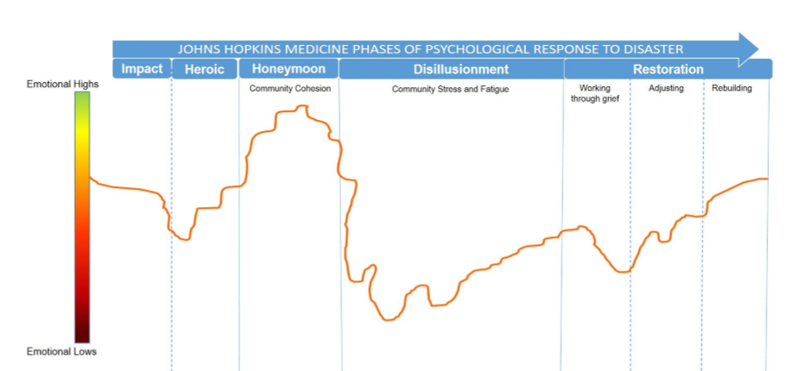
Phases of Psychological Response to Disaster 2020
Developed on behalf of the Office of Well-Being by George S. Everly, Jr., PhD; Carolyn J. Fowler, PhD, MPH; Albert W. Wu, MD, MPH and Deborah Dang, PhD, RN
Notes:
…”. Our messages to leadership have been around these points:
-experience of disaster is grounding our response
-model was adapted for covid and JHM by in-house experts
-what people need varies according to what phase they are in
-our work is anticipating the phase people are in, and to deliver care and programs to address needs
Maintaining Community Cohesion as a goal
This is different than a hurricane or earthquake. A pandemic is a disaster of Uncertainty
Unprecedented – except 1918 Flu

Slide 4
Disaster of Uncertainty
Morbidity/Lethality
X
Duration
X
Ambiguity
George S. Everly, Jr., PhD, Disasters of Uncertainty, Psychology Today, 2020
Notes:
Infectious diseases are the most psychologically toxic disasters of all for those who will survive. Toxicity from Ambiguity and Uncertainty
Disasters with ambiguity with regard to their respective nature and uncertainty with regard to their trajectory, before, during, and even after their impact increase psychological toxicity and will create the largest number of “psychological casualties”

Slide 5
Cross-sectional study of Health Care Workers treating COVID-19 Patients
1257 Health Care Workers (nurses and physicians)
34 Hospitals with fever clinics or COVID-19 wards
January 29, 2020 to February 3, 2020
Assessments for symptoms of depression (PHQ-9), anxiety (GAD-7), insomnia (ISI), and distress (IES-R)
Notes:
Later in the process than we, but still relatively early in the response.
60% nurses and 40% doctors
Insomnia Severity Index (ISI) and Impact event Scale (IES)
Triggers: Personal safety (adequate PPE), keeping family safe (bring the infection home to family), being redeployed (not having the training to provide excellent care), and concerns about having adequate materials (ventilators, ICU beds, etc.) to provide care.

Slide 6
Severity categories of Depression (PHQ-9)
Lai et al., JAMA Network Open, 2020

Slide 7
Severity categories of Anxiety (GAD-7)
Lai et al., JAMA Network Open, 2020

Slide 8
Survey of HCW in Italy March 2020; 1379 HCW
Psychological symptoms | % reporting symptoms
Symptoms of Post Traumatic Stress | 49%
Symptoms of Depression | 25%
Symptoms of Anxiety | 20%
Insomnia | 8%
High perceived stress | 22%
Higher rates for women, frontline line HCW, and younger HCW
Rossi et al., JAMA Network Open, 2020
Notes:
TRANSITION TO THE POTENTIAL CLINICAL CHALLENGES – BURNOUT, ANXIETY, PTSD, and DEPRESSION
Approximately 1/3 nurses, 1/3 physicians, 1/3 other HCW

Slide 9
Definition of Burnout
Pathological syndrome in which emotional depletion and maladaptive detachment develop in response to prolonged occupational stress
Maslach et al., Curr Dir Psychol Sci 2003; 12:189-192.

Slide 10
Maslach’s Dimensions of Burnout
Emotional Exhaustion (EE)
Work demands deplete individual’s energy
Depersonalization (DP) and Cynicism
Individual detaches from the job
Feelings of inefficiency
Individual perceives a lack of personal achievement
Maslach et al., In Evaluating Stress: A Book of Resources, 1997
Notes:
VERY HARD TO DISTINGUISH FROM DEPRESSION

Slide 11
Factors common to multiple surveys about burnout in residents
Increased work hours
Conflict between work and home life
Anxiety about clinical competence
Intensity of the workday
Perception of work as stressful
Stress in relationship with nurses
Stress in relationships with faculty and senior residents
Thomas NK, JAMA 2004;292: 2880-2889
Notes:
HARD TO DISTINGUISH FROM DEPRESSION
Most consistent: intensity (not length) of work day and conflict with home life
Demographics/gender not consistently associated
Higher debt positively correlated
Having your own children associated with less cynicism
Personality type not with clear association but may mediate interactions with supervisors and/or responses of supervisors

Slide 12
Anxiety Response Cycle
Anxiety
Increases
Avoidance
Safety Behavior
Anxious
Interpretation
Trigger
Perpetuates Anxiety,
Fears Never
Disconfirmed
Anxiety Decreases
Temporarily

Slide 13
Response to anxiety
Two options with anxiety
Avoid
Tolerate the distress
The disability associated with anxiety disorders often comes from avoidance

Slide 14
Symptoms of Generalized Anxiety Disorder (GAD)
Excessive anxiety or worry occurring more days than not for at least 6 months about a number of events or activities
The patient finds the worry difficult to control
At least three (or more) of these 6 symptoms:
Restlessness or feeling keyed up or on edge
Being easily fatigued
Difficulty concentrating
Irritability
Muscle tension
Sleep disturbance

Slide 15
Symptoms of Panic Attack
Palpitations, increased heart rate
Sweating
Trembling, shaking
Shortness of breath or smothering
Feeling of choking
Chest pain or discomfort
Chills or hot flashes
Nausea or abdominal distress
Feeling dizzy, faint, unsteady, or lightheaded
Derealization or depersonalization
Fear of losing control or going crazy
Fear of dying
Tingling of arms, legs, or face
Notes:
If concerned must first FULLY ELIMINATE the possibility of a cardiac or other medical cause

Slide 16
PTSD: Traumatic Event
The person experienced, witnessed, or was confronted with an event that involved actual or threatened death or serious injury, or a threat to the physical integrity of self or others
The person’s response involved intense fear, helplessness, or horror
Often with feelings of lack or loss of control
Notes:
Rape, domestic violence, traumatic experiences associated with pregnancy/delivery
EXPERIENCED PROVIDERS MAY HAVE DIFFERENT REACTIONS

Slide 17
Posttraumatic Stress Disorder (PTSD)
Persistent re-experiencing of the traumatic event
Recurrent, intrusive, distressing recollections of the event
Recurrent distressing dreams of the event
Flashbacks – acting or feeling as if the event were recurring
Intense distress at exposure to internal or external cues that symbolize or resemble aspects of the event
Attempts to avoid thoughts and activities associated with the event or inability to recall aspects of the trauma
Persistent symptoms of increased arousal
Difficulty falling or staying asleep or difficulty concentrating
Irritability or outbursts of anger
Hypervigilance or exaggerated startle response

Slide 18
Symptoms of Major Depression
Depressed or irritable mood or feeling nothing
Decreased interest or pleasure in activities (anhedonia)
Change in appetite or weight
Sleeping more or less than usual
Feeling restless or slowed down
Fatigue or loss of energy
Decreased concentration
Feelings of guilt or worthlessness
Recurrent thoughts of death or suicide
Notes:
5 or more symptoms
Not capable of generating positive emotions – do not suggest a gratitude journal
THIS IS AN ILLNESS MUCH MORE COMMON IN WOMEN – 20% of WOMEN WILL HAVE A DEPRESSIVE EPISODE

Slide 19
Healthy Coping Strategies
Exercise and other physical activities
Interacting with friends and family
Prioritizing sleep
Healthy eating habits
Hobbies
Being more “present focused”
Mindfulness Meditation
Formal or informal support groups
Seeking treatment
Notes:
“wellness is not prescriptive”
Pick things you like – hobbies, exercise, reading, anything.

Slide 20
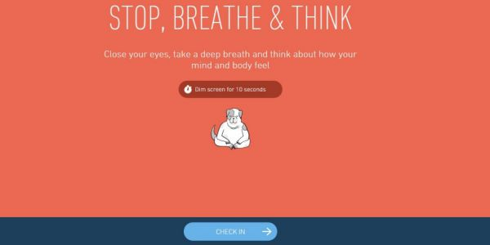
Mindfulness meditation practices
Top 20 Mindfulness Apps
https://positivepsychologyprogram.com/mindfulness-apps/#daily-mindfulness
Notes:
Mindfulness is form of resilience training
CALM APP free to all Hopkins staff

Slide 21
Unhealthy Coping Strategies
Alcohol
Other drugs
Risky behaviors
Deciding that you do not have a problem and do not need help because you do not want to have a problem
Notes:
RISKY BEHAVIORS – affairs, dangerous driving, wild trips.

Slide 22
Individual Evaluation and Treatment
University Health Services – Mental Health
Providing care to medical students, house staff, fellows, and their families
Evaluation and follow-up treatment
Call UHS-MH to schedule 410-955-1892
Notes:
Early on referrals of those with exacerbations of pre-existing psychiatric conditions

Slide 24
https://www.hopkinsmedicine.org/joy-at-jhm/office-of-well-being/index.html
Email: owb@jhmi.edu
Notes:
“Office of Well-Being” Office serves all JHM entities, JHHS, and the SOM. Leaders can point their staff to one place for staff supports under covid.
INTEGRATED + COMPLEMENTARY + MULTIDISCIPLINARY

Slide 25
Physicians as patients
35% of physicians do not have a regular source of health care
Only 22% of medical students who screened positive for depression received mental health services
Only 42% of medical students reporting suicidal ideation received treatment

Slide 26
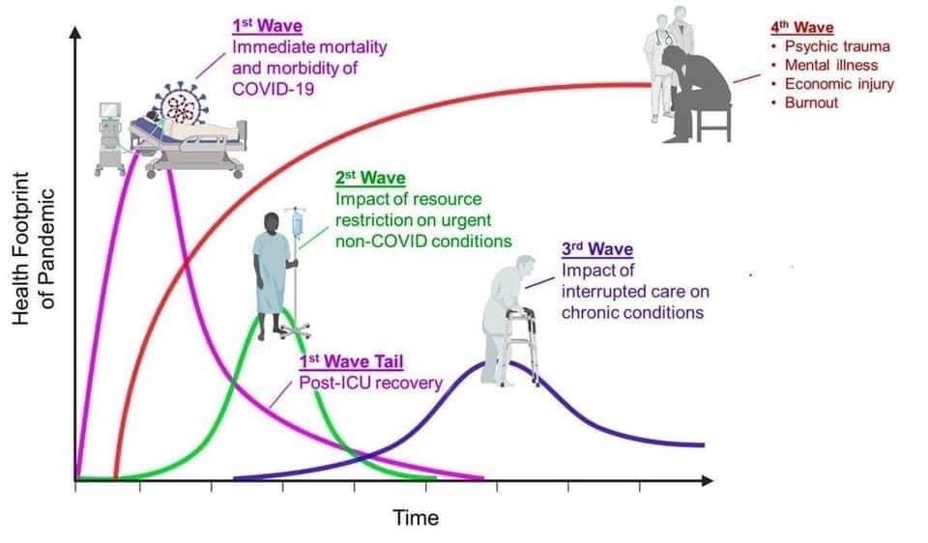
Predicted waves of impact
Dr. Victor Tseng, 2020
Notes:
Dr. Victor Tseng, ICU physician

Slide 27
Conclusions
There will be serious psychiatric and psychological consequences of the COVID-19 pandemic for Frontline HCW
PTSD, depression and anxiety disorders will likely be among the serious outcomes
Johns Hopkins has an integrated continuum of support services available

